Slide 1
AMES House
Price Prediction
Group TTP
Bee Kim
Drucila Lefevre
Ira Villar
Tomas Nivon

Slide 2
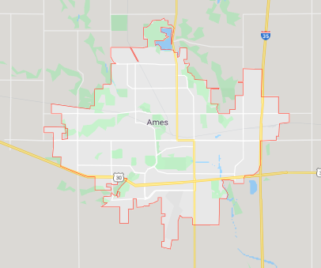
Background information
Ames, Iowa
80 Variables
2006-2010
Train Set
Sale Price
1460 Data
Test Set
1459 Data
Root-Mean-Squared-Error (RMSE) between predicted value and observed sales price
Source: GoogleMap
Notes:
Among 80 Variables, 20 continuous, 14 discrete, 22 categorical, 24 ordinal
Oldest : 1872, newest : 2010

Slide 3
Objectives & Process
Predict Sale Price using Train and Test dataset
1. Understanding the data
EDA
2. Cleaning the data
Drop Outliers
Drop Columns with Many Missing Values
Imputation on Missing Values
Skewed Numerical Variable Distribution -> Box-Cox Transformation
3. Feature Engineering
4. Machine Learning models

Slide 4
1
Understanding the Data

Slide 5
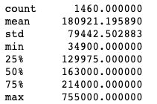
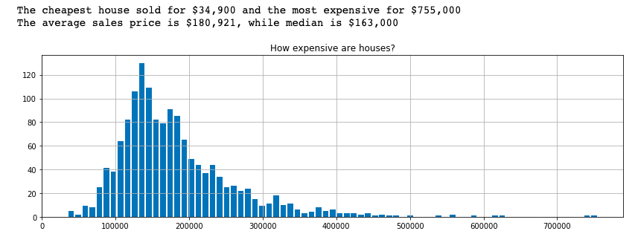
Objective: House Sale Price
Notes:
Target Variable

Slide 6
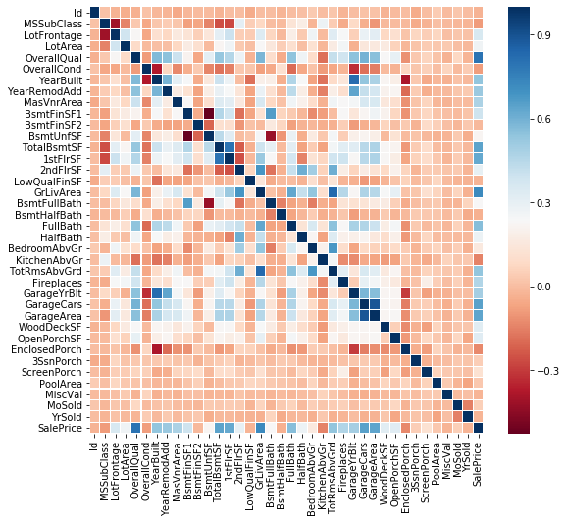
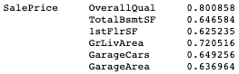
Numeric Variables Heatmap

Slide 7
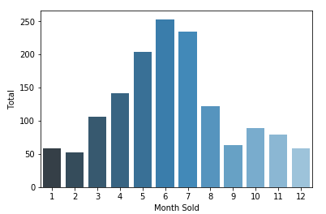
Number of House Sold by Month

Slide 8
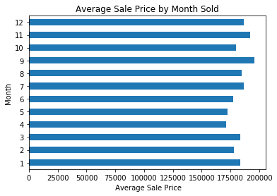
Average Sale Price by Month
Notes:
This indicates the number of house sold that was previously seen in the last two slides. Does not indicate the high and low from this current page. Lagged indicators

Slide 9
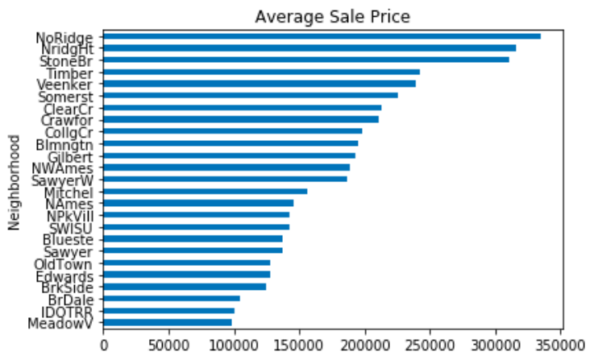
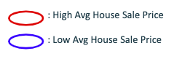

Slide 10
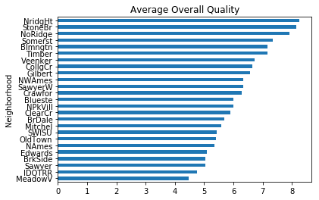

Slide 11
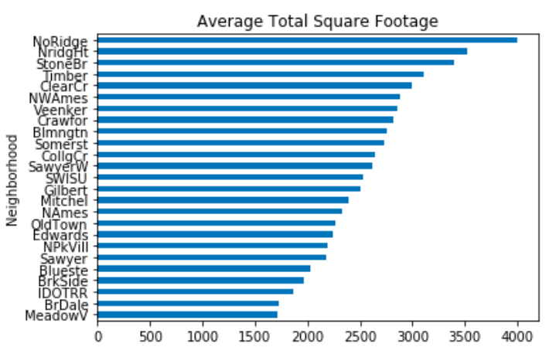

Slide 12
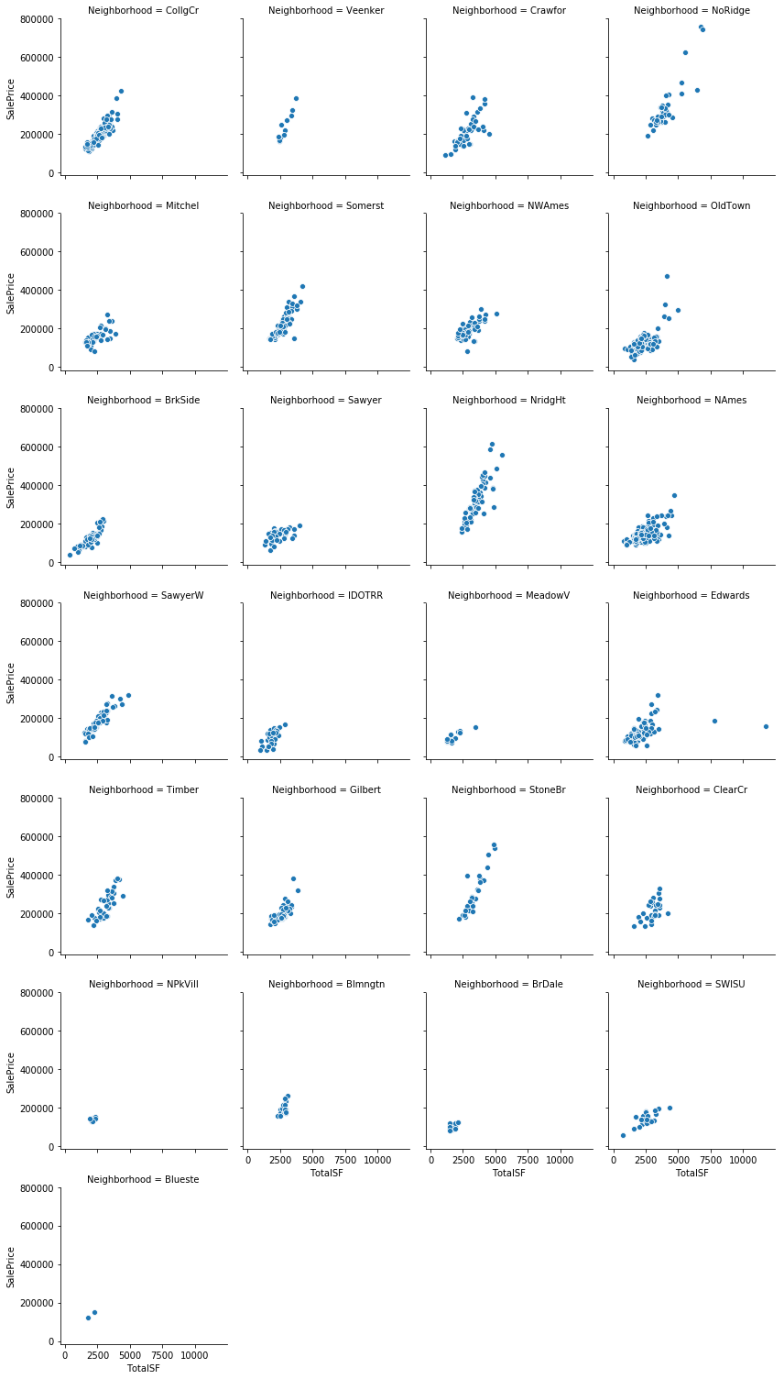
Impact of Total Square Feet on Different Neighborhoods
Different neighborhoods seem to have premiums/discounts for SF
Notes:
Slope -> how quickly the price rise. => neighborhood matters. Interaction between sqft and neighborhood (not only one variable itself)

Slide 13
2
Cleaning the Data

Slide 14
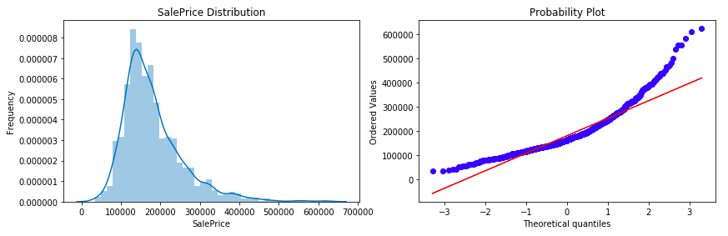
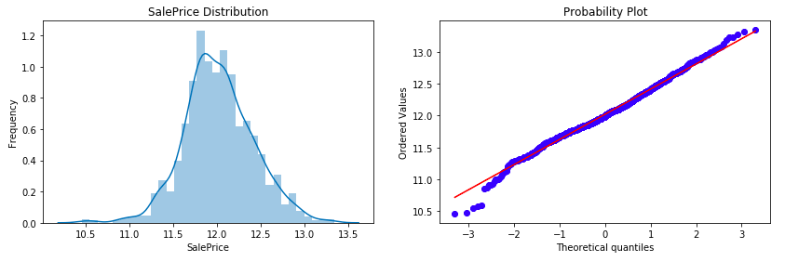
Skewness in Sale Price
Notes:
RIGHT SKEW -> remove the skew, unequal distribution by taking log -> reduce impact of outliers and reduce bias

Slide 15
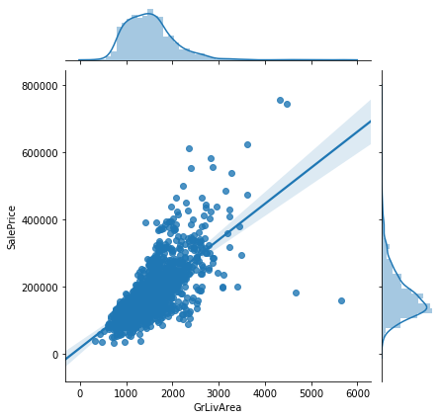
Data Preparation: Outlier Detection
Notes:
Go Over this. -> to produce a better fit? (it can skew its result of prediction and diminishes its accuracy?) -> check Z-score?!!!! (3SD) maybe describe what the graph is

Slide 16
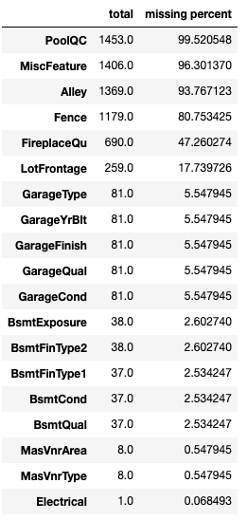
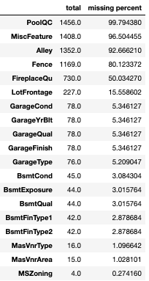
Data
Preparation:
Missing Values
Training
Test
PoolQC, MiscFeature, Alley, Fence -> Removed the columns due to over 80% missingness.
Some missing only in Test set -> Combined Training and Test dataset to impute missing.

Slide 17
Data Preparation: Imputation
Fill with “0”
ScreenPorch -> If there is missing value, it might mean there is no screen porch area
Fill with “No”
BsmtQual -> If there is missing value, it might means that there is no basement
Fill with Mode
LotShape -> If there is missing value, most likely to follow the mode or “regular” lot shape
Notes:
Assumed that certain ordinal variables:

Slide 18
Data Preparation:
Skewed Numerical Variables -> Box Cox
Dummy Variables
CONTINUOUS numerical variable skewness > 0.75
LotFrontage, LotArea, MasVnrArea, BsmtFinSF1, BsmtUnfSF, LowQualFinSF, GrLivArea, GarageArea, PoolArea, MiscVal, TotalSF, TotalPorchSF
Purpose: to run some machine learning algorithm (like linear regression) that can’t handle label data
Notes:
Why 0.75? -> because abs skewness > 1 is highly skewed, and abs skewness > 0.5 is moderately skewed so we made between 0.5 and 1 as a cutoff.

Slide 19
3
Feature Engineering

Slide 20
Added New Variables
Dropped redundant Variables
Total Square Feet of the House
Total Number of Bathrooms
Total Square Feet of the Porch
Ratio of Above Ground Square Feet to Total Square Feet
Percentage of Finished Basement over Total Basement
Years between Year Remodeled and Year Built
Years between Year Sold and Year Remodeled
Neighborhood dummy variable * Total Square Foot
Neighborhood dummy variable * Overall Quality
Data Description
Notes:
Total SF = TotalBsmtSF + 1stFlrSF + 2ndFlrSF
TotalBath = BsmtFullBath + FullBath + 0.5 * BsmtHalfBath + 0.5 * HalfBath
TotalPorchSF = 3 Season Porch + ScreenPorch + WoodDeckSF + OpenPorchSF + EnclosedPorch
percent_grliving = GrLivArea / TotalSF
Percent_BsmtF = (BsmtFinSF1 + BsmtFinSF2) / TotalBsmtSF
YrRemMinBui = YearRemodAdd - YearBuilt
YrSoldMinRem = YrSold - YearRemodAdd
‘NeighborhoodName’SF = TotalSF * Neighborhood_‘NeighborhoodName’
‘NeighborhoodName’Qual = OverallQual * Neighborhood_‘NeighborhoodName’

Slide 21
4
Machine Learning Models

Slide 22
Machine Learning Algorithms
Model Type | Step 1 | Step 2
Linear | OLS Lasso Elastic Net | Stacked
Nonlinear | Random Forest XGBoost
Preprocessing
Fit linear models
Tune hyperparameters - GridSearchCV
Compare train-test RMSE
Test different combination of conditions in preprocessing
Fit more models(RF, XGB)
Tune hyperparameter -
GridSearchCV
Average models

Slide 23
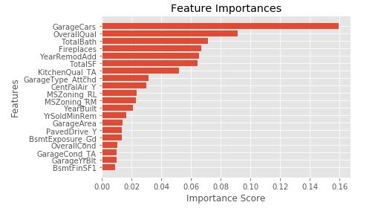
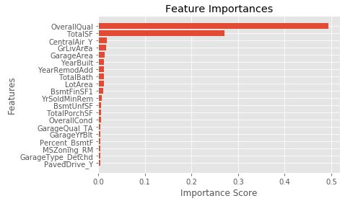
Feature Importance
XG Boost
Random Forest
Common Features across models:
: Overall Quality, Total SF, Year Built, Years since remodeled, Year Remodel, Percent of Basement Finished, SF of finished Basement
Notes:
So, we found that feature engineering was very important.

Slide 24
Conclusion
Further Improvement
 | Kaggle
OLS | 0.12215
Lasso | 0.12104
ElNet | 0.12611
RF | 0.1441
XGB | 0.12787
Stacked | 0.124
-Lasso produced the best result on Kaggle
-> More advanced models didn’t outperform the linear regression models.
-Importance of Feature Engineering
-Non-linear models without imputation and dummy variables.
-Seasonality -> time series.
-Combine similar Neighborhood and do imputation based on Neighborhood.
Notes:
Do imputations based on those variables.
If specific neighborhoods have characteristics that we can better impute on the smaller neighborhood.

Slide 25


Thank you.

